Slide 1
Safety Net
Arianna Burch, Sofia Lee, An Huynh
“computer vision & iot meet
unbiased facial recognition“

Slide 2
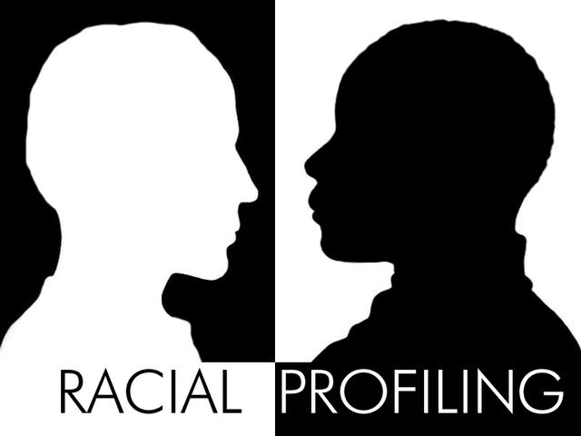
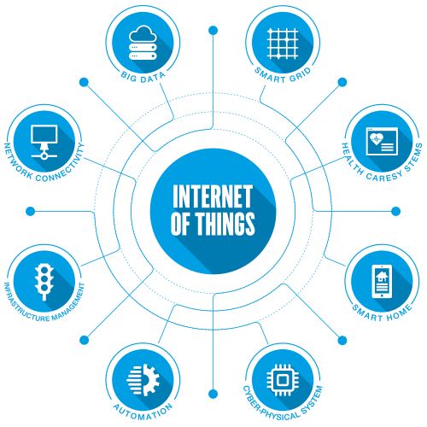
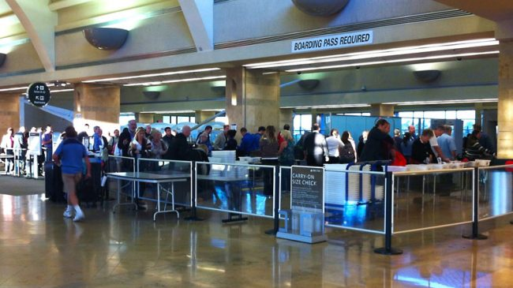
Inspiration
Work on project with topics none of us have worked with before - Computer Vision and IoT
Face Recognition application - connected to pi and can be run on web
Use Cases: Security, social applications, accessibility, etc.
But data inequality comes into play...

Slide 3
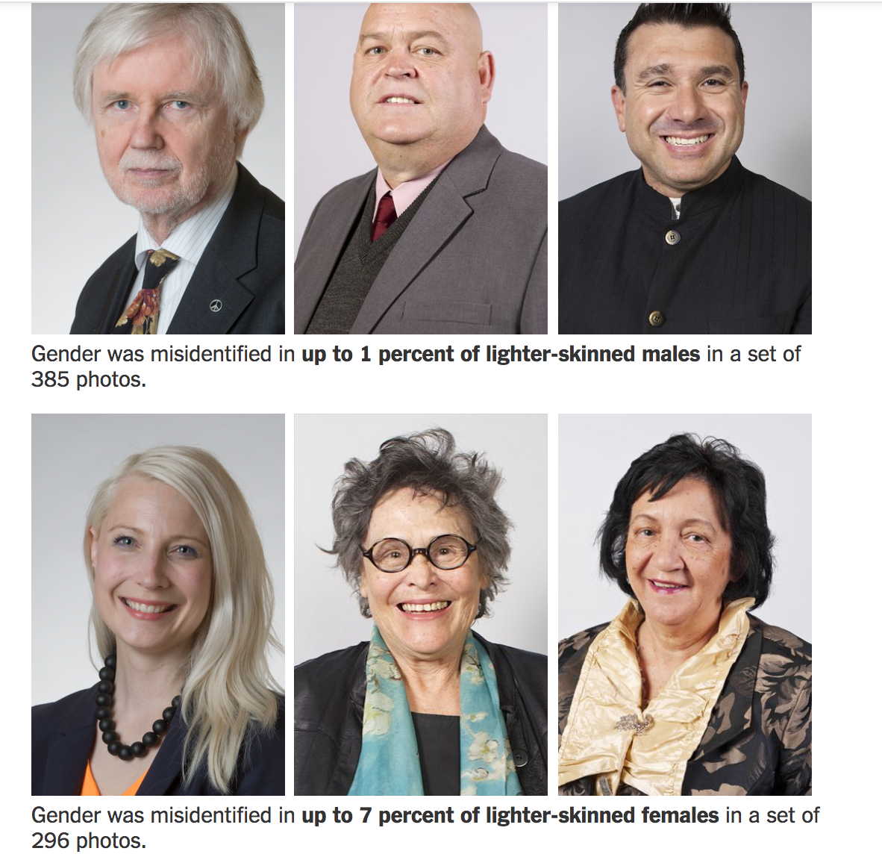
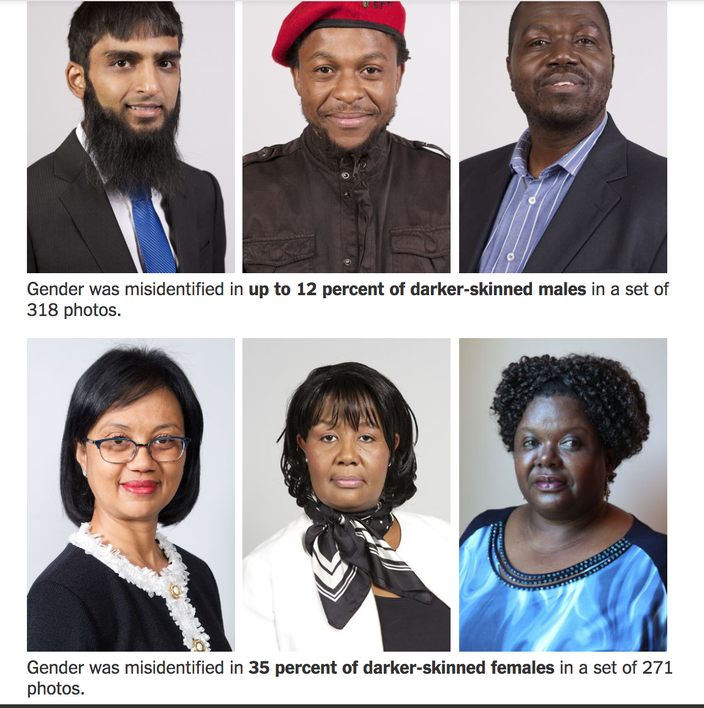
Unbiased Computer Vision Datasets?
Large industry facial recognition models have been found to be biased by gender, race, and other factors, not insignificantly
Ex. Microsoft, IBM, plus open-source academic datasets

Slide 4
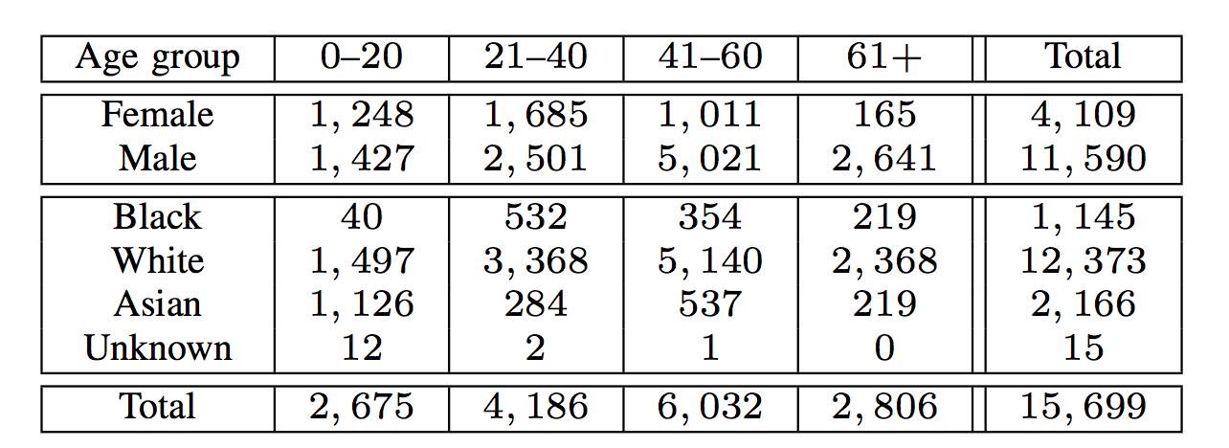
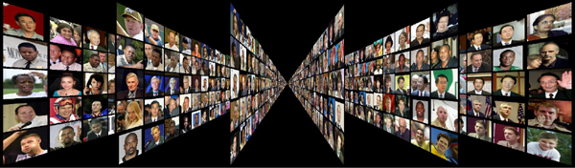
Unbiased Computer Vision Datasets
Labeled Faces in the Wild (LFW) - popular unconstrained face dataset
Disproportionately white, male, etc.
How does this reflect our societal bias?
Distribution of LFW Dataset

Slide 5
Building an Unbiased Computer Vision Dataset
Based on celebrity subset of LFW, but heavily customized
Manual insertion of new images/individuals across a broad spectrum of identities
More representative of the faces of America and world
Distribution of our Dataset Relative to LFW (Qualitatively)
Equal ratio of races | Body shape diversity | Varying sexual orientations
50/50 male female | Wide range of ages | Religious diversity
Robust images | Cultural/ethnic diversity | Many types of “celebrities”

Slide 6
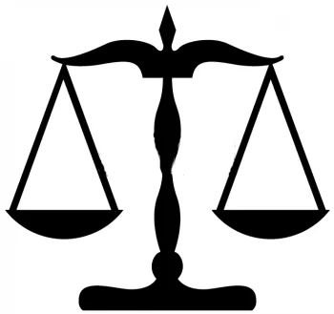
Fairness Increases Social Good
Streamlined and non-discriminatory security systems
Potential use-cases in schools and airports
Not for profit and charitable applications
Crisis or accident warnings that don’t ignore people in need
Ex. elder care, fall alerts
Fairness increases data quality, and good data

Slide 7
Demo

Slide 8

Further Work
Better (more), high-quality data
Improve performance, robustness, and representativeness
Hardware integration
Software for existing hardware/security systems
Data security and privacy requirements

Slide 9
Thank you!

